Slide 1
HW5- Number Guessing

Slide 2
Introduction of Number Guessing
System generates an initial 4-digit number from 1 to 9.
4 digits cannot be the same.
If one digit of the guessed number is at the same position and with the same value with the Initial number, mark 1A.
If one digit of the guessed number is at wrong position but with the same value with the Initial number, mark 1B.
Example: Initial number:4681 Guess number:1284 1A2B Guess number:7679 1A

Slide 3
HW5
Please write a program that randomly generate an initial 4-digit number, each from 1~9
These 4 numbers cannot be the same.
1234 (O), 1233 (X)
The program asks the user to guess the number. The user input a 4-digit number, each from 1~9
These 4 numbers cannot be the same.
1234 (O), 1233 (X)

Slide 4
HW5
The program response errors or xAyB, where x and y are numbers.
If the input format is wrong, the program outputs errors and asks the user to input again.
If the input type is correct, the program outputs xAyB and keeps asking the user to guess.
If the result is 4A0B, the program outputs “you win!” and asks the user whether he/she wants to continue or not.

Slide 5
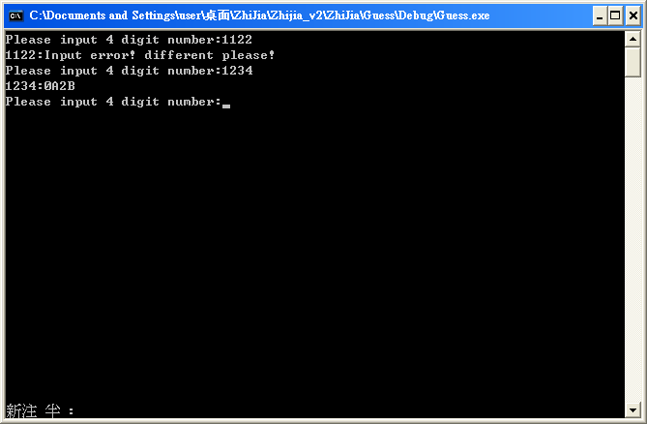
Example
Program output format

Slide 6
Hint
How to get input number without using array:
int input=0;
cin>>input;
int a1 = input / 1000;
int a2 = ?
int a3 = ?
int a4 = ?
What is the difference between / and % ?

Slide 7


